Slide 1
Python Programming

Slide 2
Session 3
Topic 1: Python Programming
Print Functions
Formatting printing output
Topic 2: Python Literals
Introduction to Literals
Integers
Floats
Strings
Booleans

Slide 3
Hello World!
Let’s get down to business and we’ll code some lines.
The print() function can be used to display a message.
E.g. “Hello”
Notice that we used quotation marks for the message. This is called a string.
A string treats its contents as plain text (even when they include numbers).
We’ll cover data types towards the end of the session.
If we don’t include the quotation marks, it would try and print a variable called Hello, which we haven’t made and as such, doesn’t exist.
You can use either single or double quotation marks, both will work (but can help when trying to include one or the other inside your string).

Slide 4

My first application
We’re going to create a simple Python application.
We want to put the data of the function inside the brackets.
E.g. print(“Hello world!”)

Slide 5
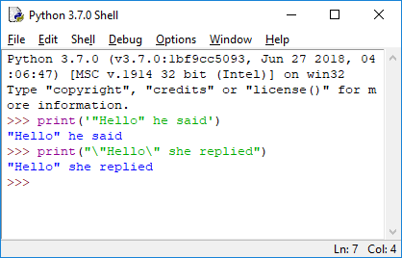
Formatting print outputs
There are numerous things that can help to format your printing output.
Remember that you can use both single and double quotation marks.
e.g. “Hello” and ‘Hello’ will show the same.
This can help when displaying the quotation marks.
Another way to achieve this is through placing a backslash before the quotation mark in the string.
e.g. “\“Hello\””

Slide 6
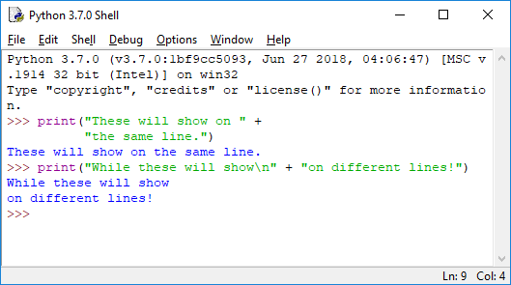
Formatting print outputs
We can also add strings together from multiple lines or variables, or designate new lines.
\n will start a new line
The + symbol is used for concatenation,
something we will discuss in more detail
in later weeks, but to put it simply, it joins
like-types together, in this case two strings.

Slide 7
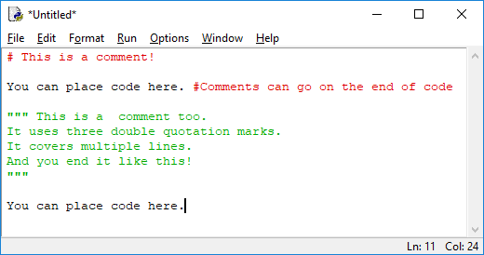
Comments
Comments are a good way in which we can keep track of what our code does, the logic behind it, and notes for direction, change, or even authorship.
There are two main ways of commenting code:
Hash: # (Single Line comment)
This will comment out the rest of the line
Three quotation marks: ””” (Multiline Comment)
This will comment out all space until another ””” is written

Slide 8

Comments
Three quotation marks: ”””
A nifty trick for printing something exactly how you want it is to use the three quotations within a print statement, it will print it exactly how you represent it inside the string, spaces, lines, and all.
For example:
print(””” This O O
Will T
Keep The \___/ Exact Spaces!”””)
Notes:
If your program shows error, Check whether you have given correct quotation mark?

Slide 9
Variables and Literals (Data types)
Variables are a container for data that can be assigned to it. They’re often given names or letters (such as in maths, X = 23).
NOTE: = and == are two very different things.
= is used when assigning a value to something, such as the variable above.
== is used when checking if something is equal to a value (i.e. if 1 == 1).

Slide 10
Assigning a variable = easy
Variables allow us to assign a value for something that can be used multiple times or in multiple areas.
E.g. helloWorldMessage = “Hello world!” Don’t forget your camel casing!
E.g. varPi = 3.1459
After having assigned a variable we can then use them later on multiple times and it will always reference that value (unless changed).
helloWorldMessage = “Hello world!”
print(helloWorldMessage)

Slide 11
Assigning a variable = easy?
Let’s jump ahead just a little bit for a few tips in todays activities:
We can use the input() function to allow the user to enter something. This can even be used to assign what is entered into a variable, too!
For example:
helloWorldMessage = input(“Enter your message”)
print(helloWorldMessage)
We can also put more than one thing in functions using the , symbol between things in the brackets:
helloWorldMessage = input(“Enter your message”)
print(“You said”, helloWorldMessage)

Slide 12
Literals
We will cover all of the data types in time, but these are the major ones.
Common data types: E.G. Python function
Integers (1) int()
Floating point numbers (1.00) float()
Complex numbers (1j)
Boolean (true/false statements)
Strings (”text”) str()

Slide 13


Questions?

